Slide 1
GCP Projects

Slide 2
Compute Engine
Google Cloud service for creating and managing virtual machines
Offers wide variety of VM-related services
IaaS

Slide 3
Virtual machines
A virtual (=not real) server running on a physical (=real) server
Allows creating new servers extremely quick
Based on existing resources of the physical server
From the user’s point of view – a regular server, nothing new
SLA of a single machine: 99.5%

Slide 4
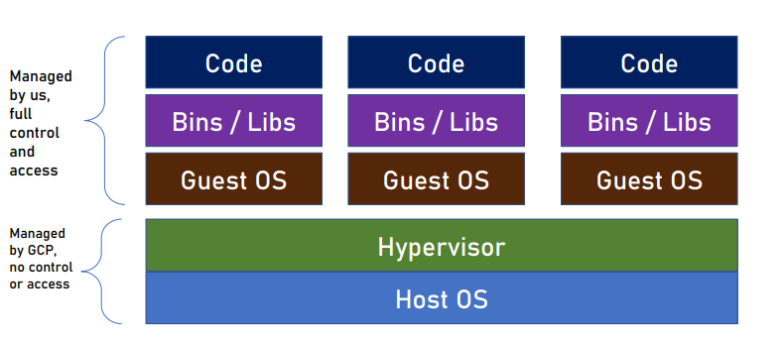
Virtual Machines Architecture

Slide 5
Advantages Of Compute Engine
Storage Efficiency: The persistent disks support up to 257 TB of storage. Organizations that require more scalable storage options can go for Compute Engine
Cost: Within the GCP ecosystem, users pay only for the computing time that they have consumed. The per-second billing plan is used by the Google compute engine.
Stability: It offers more stable services because of its ability to provide live migration of VMs between the hosts.
Backups: Google Cloud Platform has a robust, inbuilt, and redundant backup system. The Compute Engine uses this system for flagship products like Search Engine and Gmail.
Scalability: It makes reservations to help ensure that applications have the capacity they need as they scale.
Security: Google Compute Engine is a more secure and safe place for cloud applications.

Slide 6
VM Families
VMs in GCP are divided to families
Each family targets specific type of workload
Families are further classified by series and generation (usually
newer hardware)
Always make sure you select the appropriate VM family for your
needs
Documentation link :-
https://cloud.google.com/compute/docs/machine-resource

Slide 7
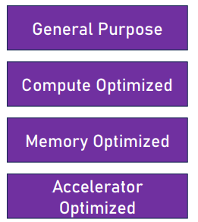
Workload Types
Web servers, microservices, virtual desktops, databases, etc
High-performance computing (HPC), game servers, media transcoding, etc.
SAP HANA databases, in-memory data stores (Redis), etc.
ML training, massively parallelized computation, deep learning etc

Slide 8
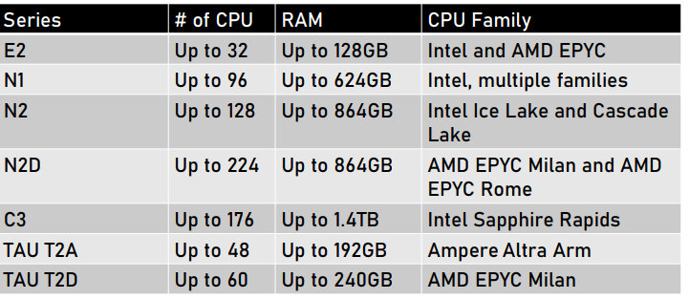
General Purpose
E2 :- Low traffic web server, back office apps, virtual desktops
N2, N2D, N1 :- Medium traffic web servers, microservices, BI
C3 :- High traffic web servers, databases, in-memory cache
TAU T2D, T2A :- ARM architecture, Cost effective, scale out workloads

Slide 9
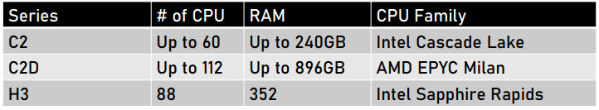
Compute Optimized
H3 :- HPC workload, scientific and engineering computing
C2, C2D :- Gaming, ad serving, media serving, AI/ML

Slide 10
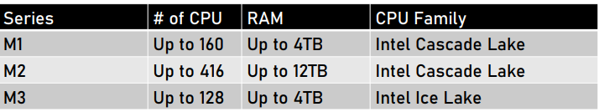
Memory Optimized
M1, M2, M3 :- SAP HANA, MS SQL, memory intensive apps

Slide 11
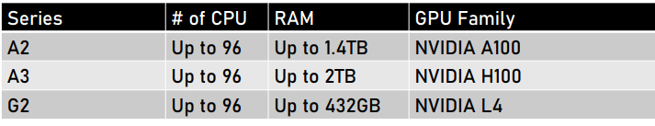
Accelerator Optimized
A2, A3 :- HPC, ML Training
G2 :- Video transcoding, Remote visualization

Slide 12
Additional GPU
Some VM series can use GPU in addition to CPU
The A2 and G2 series have built in support for GPU and no need to add it later
GPU can also be added to N1 machines
All GPUs are NVIDIA base

Slide 13
Custom Machines
If none of the predefined machine types fit your need you can create your own custom machine
Custom machines can be created in the E2, N2, N2D and N1 series
You define the number of CPU and the size of RAM
For example: 32CPU, 16GB RAM
Not all combinations are valid

